Slide 1
Syrian refugees in tripoli- lebanon
Dr. Khaled TADMORI

Slide 2
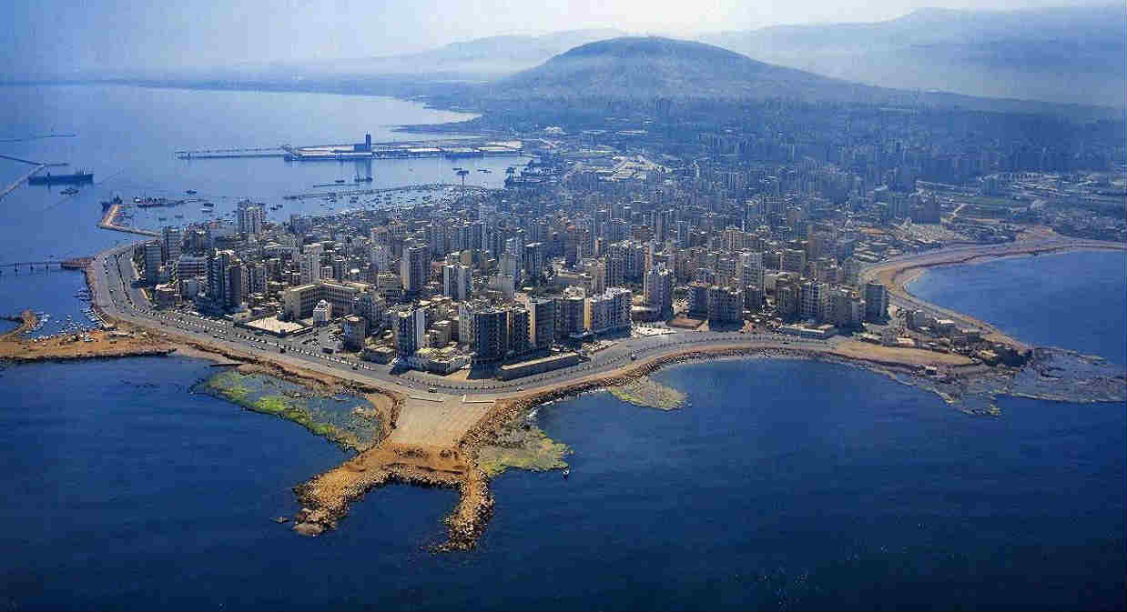
Tripoli from Above

Slide 3
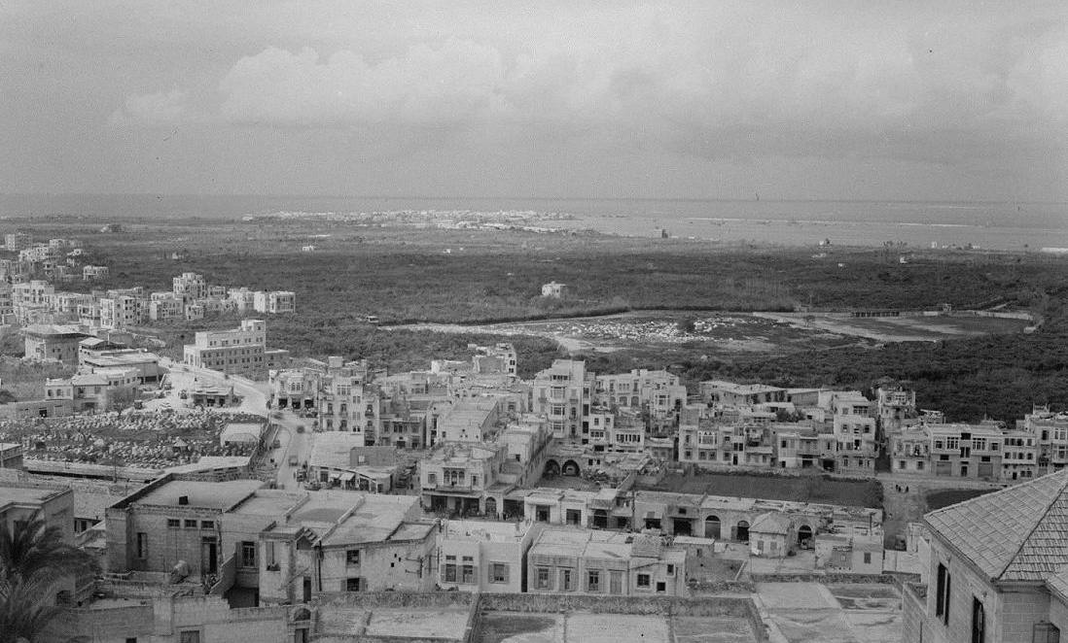
The Old Tripoli
El MINA-REGION

Slide 4
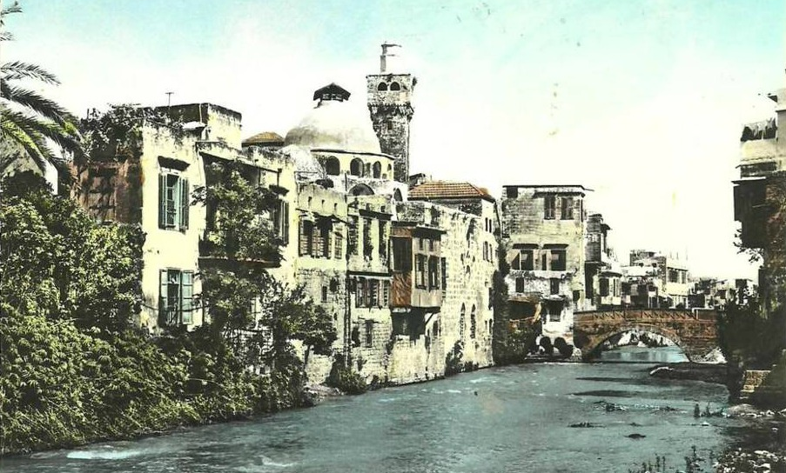

AL- Fayha’
the diffusion of a scent and that because of its vast orange plantations

Slide 5
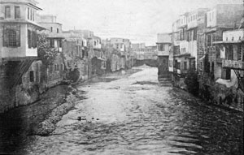
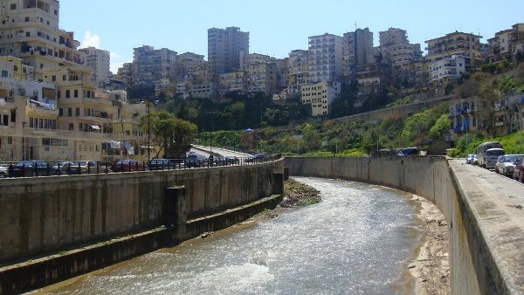
Abu Ali River
A river that comes down from the Valley of Kadisha runs in the city and is called “The River of Abou Ali”

Slide 6
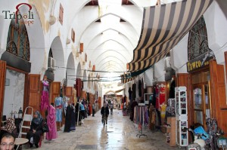
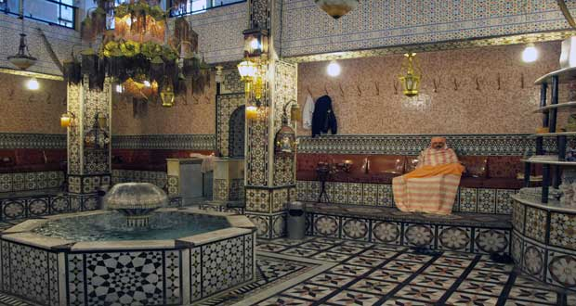
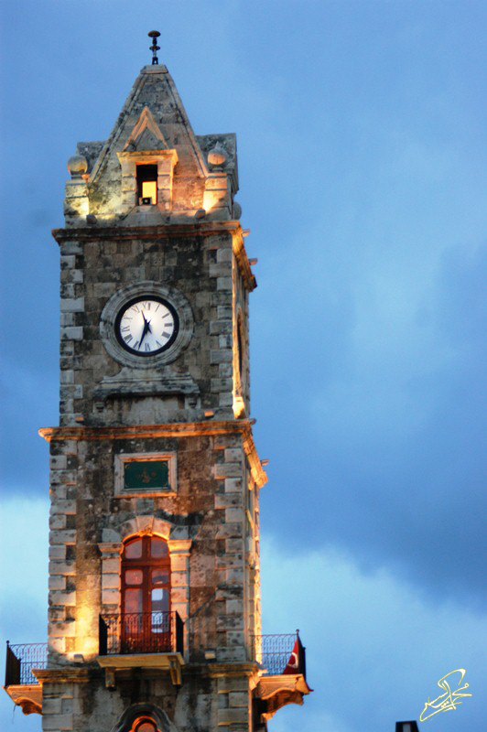
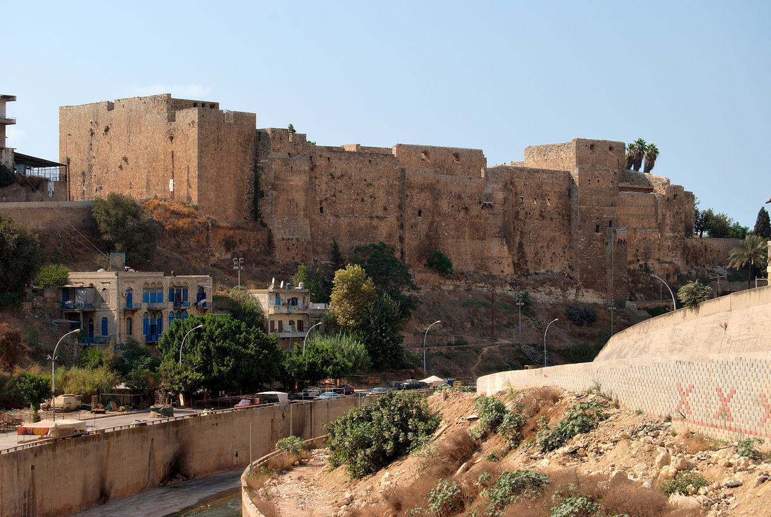
A citadel, a clock, khans and hammams….

Slide 7
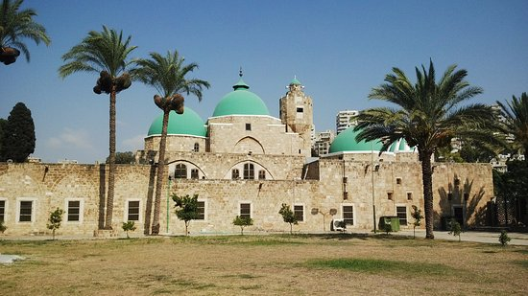
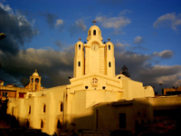
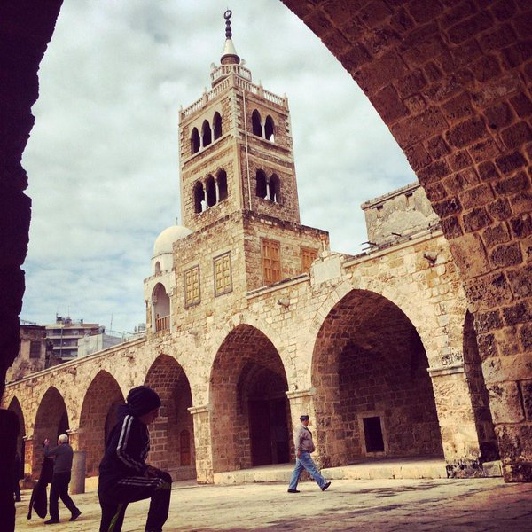
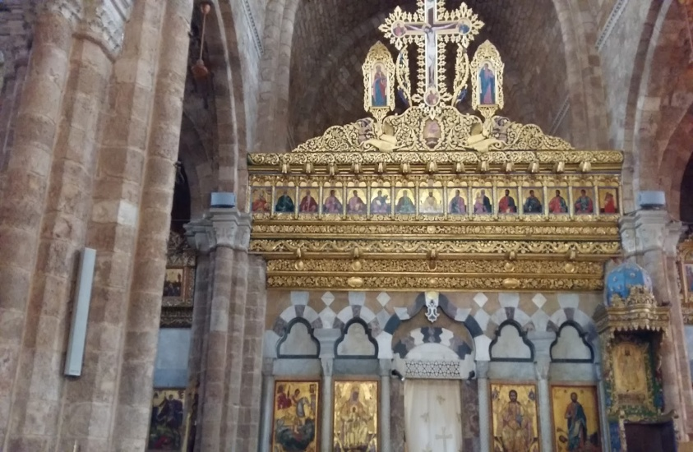
Mosques and Churches
Taynal and Mansouri Mosques
St Georges Chrch, St Maroun Church

Slide 8
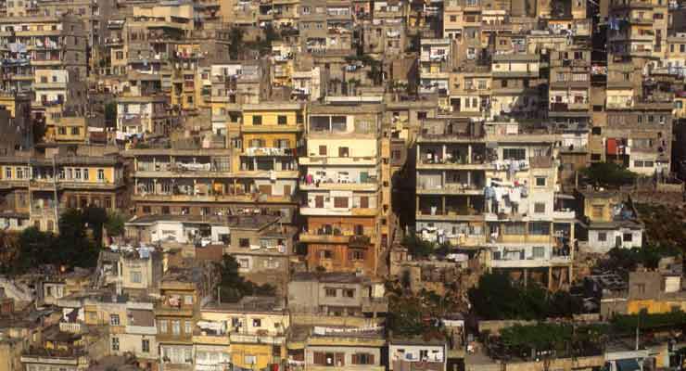
Tripoli, the poorest city on the Mediterranean Sea

Slide 9
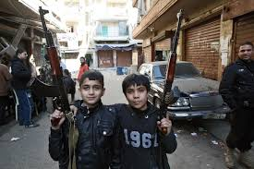
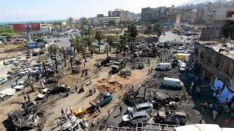
The Aspects of War in Tripoli

Slide 10
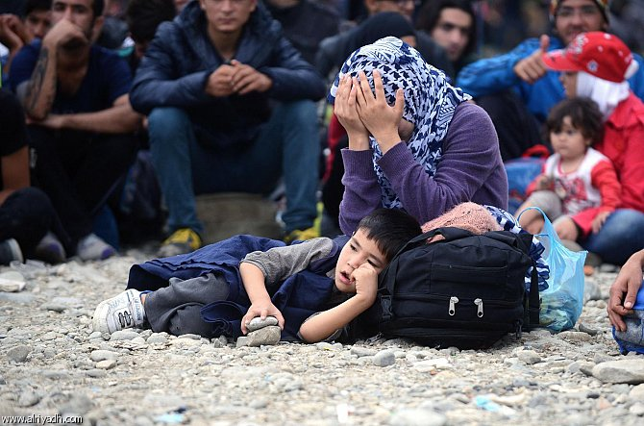
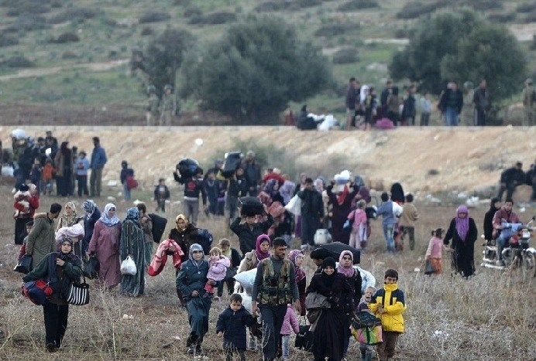
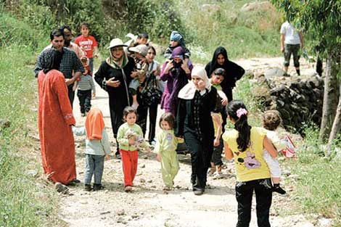
Refugees leaving Syria

Slide 11
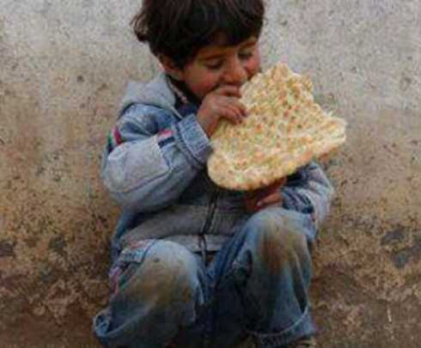
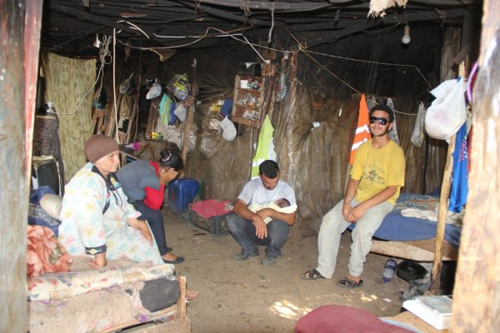
Poor Lebanese Citizens and Poor Syrian Refugees

Slide 12
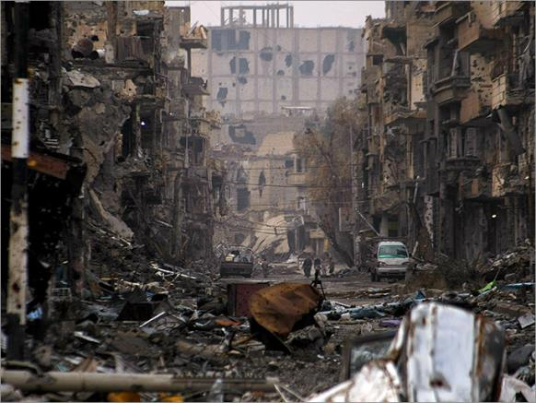
War in Syria

Slide 13
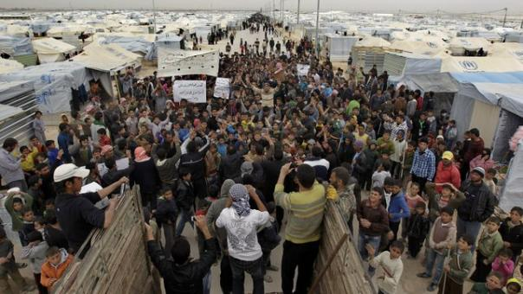
Refugees from Syria

Slide 14
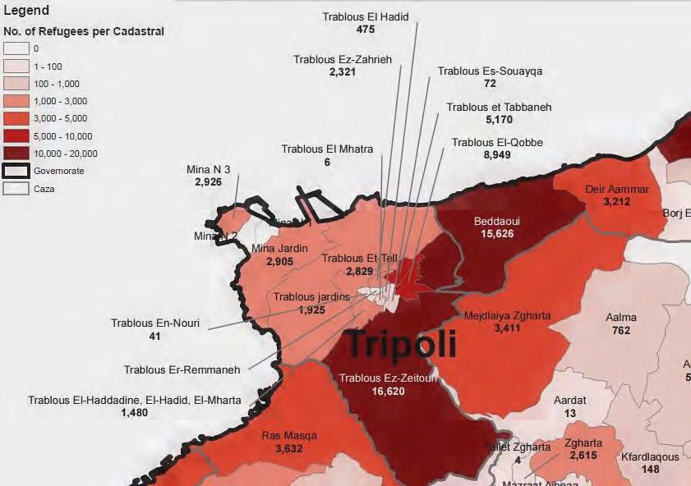
Tripoli and the distribution of the registered Syrian refugees at the cadastral level

Slide 15
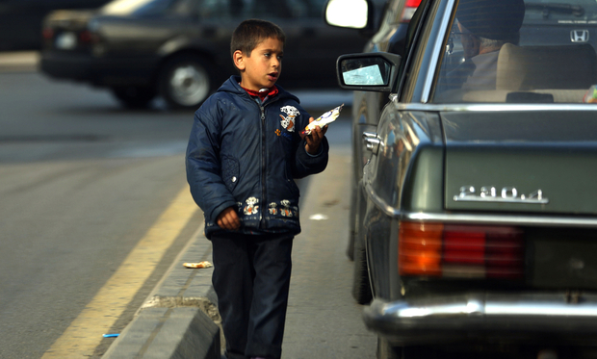
Urban Problems and the Impact of Syrian Refugees

Slide 16
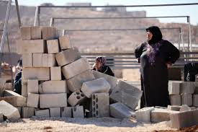
Urban Problems and the Impact of Syrian Refugees

Slide 17
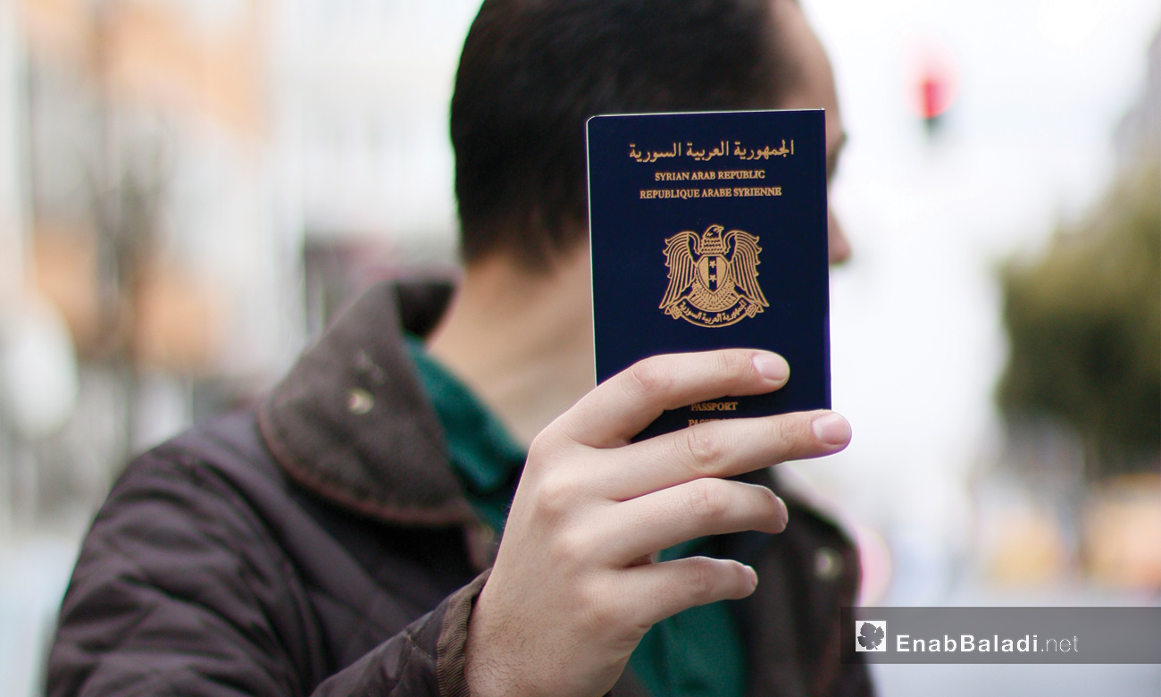
Residency Permits are a must for Syrians

Slide 18
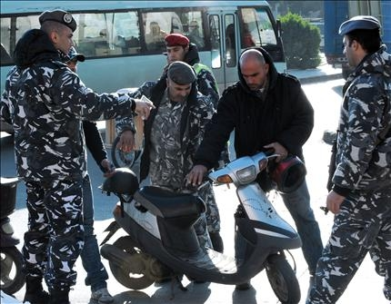
Syrians on Checkpoints

Slide 19
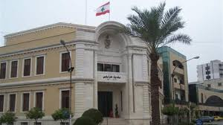
The Municipality of Tripoli
The municipality is uncapble of helping refugees. The international and national organizations offer help to them.

Slide 20
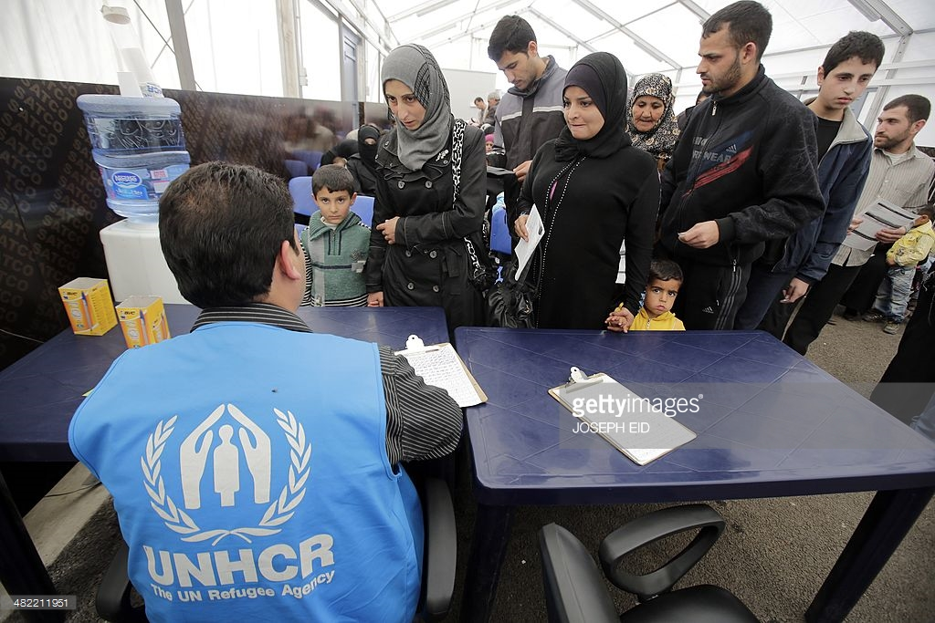
The municipality is uncapble of helping refugees. The international and national organizations offer help to them.

Slide 21
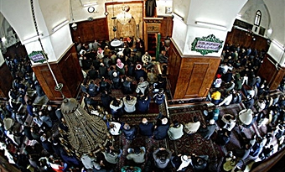
The imams call during Friday prayers to help the Syrian Brothers.

Slide 22
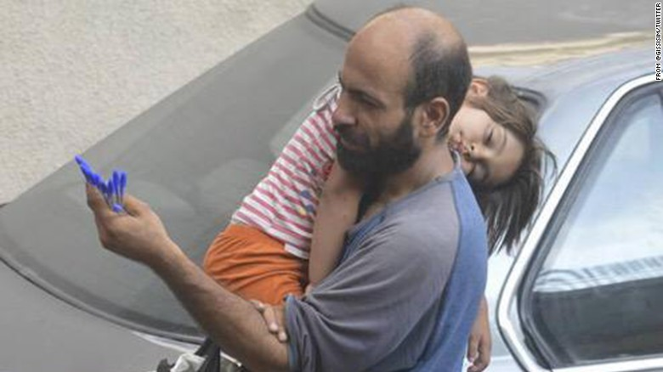
Syrian selling aids in streets of Tripoli

Slide 23
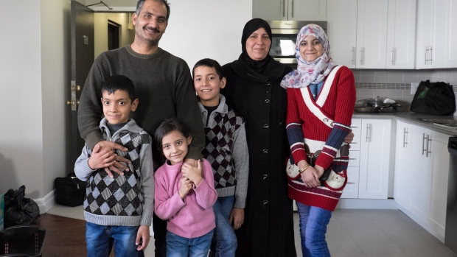
Syrians get jobs in exchange for housing

Slide 24
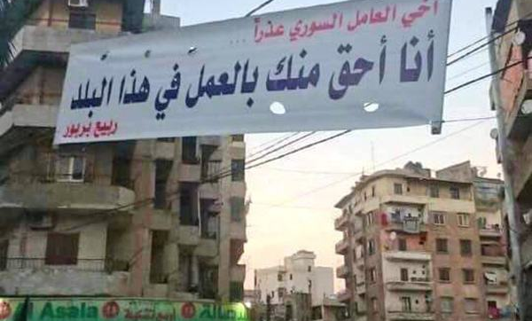
« I deserve the job more than you do! »
Lebanese citizens against offering jobs to Syrian Refugees!

Slide 25
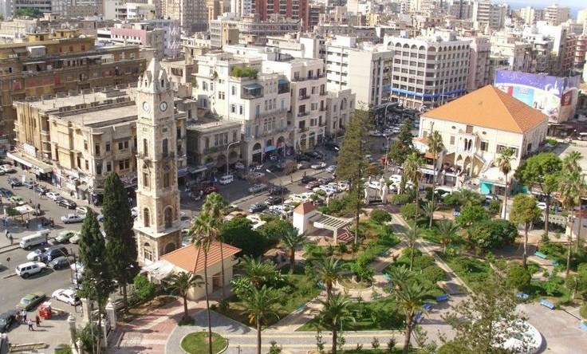
Tripoli needs infrastructure, technical support, renewable energy and green spaces for its citizens and refugees as well

